Slide 1
Advanced Security
Focus Area: Back-end

Slide 2
Training Overview
Group Workshop
Back-end
Front-end
Services
Integration
Content
Services
Advanced
Security
Overview
Widget Development
Template
Development
Targeting
Publishing
Portal Client
ICE
Foundation
Portal Essentials
Portal Technologies
Portal Tools
Portal APIs

Slide 3
Objectives
Security Concepts
Spring Security
Portal Security

Slide 4
Portal Security Key Concepts
Advanced Security

Slide 5
Key Concepts
Authentication
Authorization
A system administrator role
Notes:
When talking about security, we always come accross two key concepts: authorization and authentication. To avoid confusions, it is important to draw the distinction between these two mechanisms. And secure systems always have a system administrator role, someone who is responsible for managing authentication and authorization

Slide 6
Authentication
Authentication is the process of determining whether someone or something is, in fact, who or what he/she/it is declared to be
Notes:
Authentication is the mechanism whereby systems may securely identify their users. Authentication systems provide an answers to the questions:
Who is the user?
Is the user really who he/she represents himself to be?
An authentication system may be as simple (and insecure) as a plain-text password challenging system (as found in some older PC-based FTP servers) or as complicated as the Kerberos system described elsewhere in these documents. In all cases, however, authentication systems depend on some unique bit of information known (or available) only to the individual being authenticated and the authentication system -- a shared secret. Such information may be a classical password, some physical property of the individual (fingerprint, retinal vascularization pattern, etc.), or some derived data (as in the case of so-called smartcard systems). In order to verify the identity of a user, the authenticating system typically challenges the user to provide his unique information (his password, fingerprint, etc.) -- if the authenticating system can verify that the shared secret was presented correctly, the user is considered authenticated.
Source: http://www.duke.edu/~rob/kerberos/authvauth.html

Slide 7
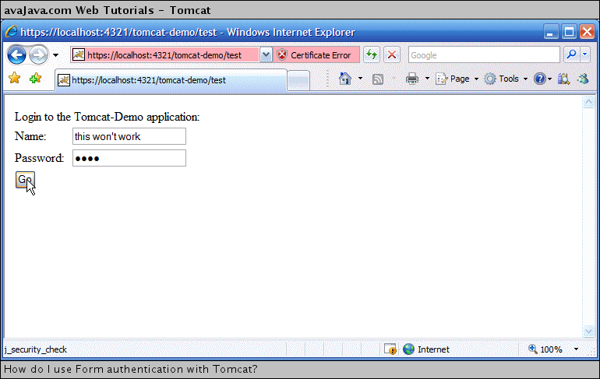
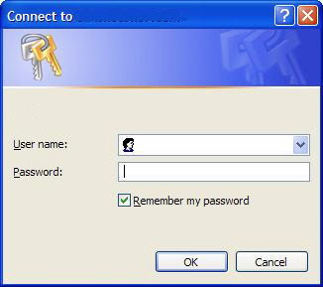
Authentication Example (1)
Notes:
We see Basic and form authentication.
Password systems are very common nowadays, even though they are considered to be weak.

Slide 8
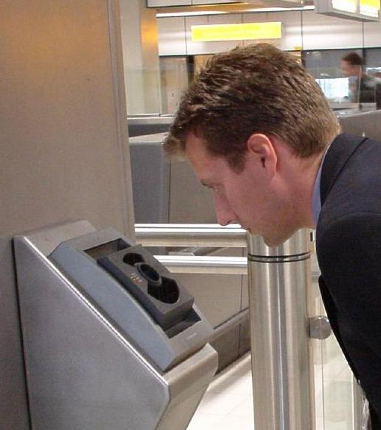
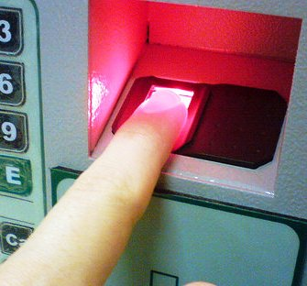
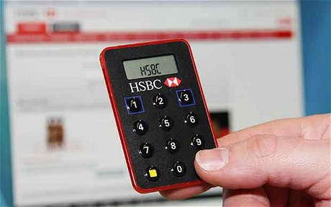

Authentication Example (2)
Notes:
We see examples of iris scan, token based, finger print based authentication and certificates.
Internet business and many other transactions require a more stringent authentication process. The use of digital certificates issued and verified by a Certificate Authority (CA) as part of a public key infrastructure is considered likely to become the standard way to perform authentication on the Internet.

Slide 9

Authorization
Authorization is the process of giving someone permission to do or have something.
Notes:
Authorization, by contrast to authorization, is the mechanism by which a system determines what level of access a particular authenticated user should have to secured resources controlled by the system. For example, a database management system might be designed so as to provide certain specified individuals with the ability to retrieve information from a database but not the ability to change data stored in the datbase, while giving other individuals the ability to change data. Authorization systems provide answers to the questions:
Is user X authorized to access resource R?
Is user X authorized to perform operation P?
Is user X authorized to perform operation P on resource R?
Authentication and authorization are somewhat tightly-coupled mechanisms -- authorization systems depend on secure authentication systems to ensure that users are who they claim to be and thus prevent unauthorized users from gaining access to secured resources.
Source: http://www.duke.edu/~rob/kerberos/authvauth.html

Slide 10
A System Administrator
In multi-user systems, a system administrator defines for the system
which users are allowed access to the system
privileges of use (access to which file directories, hours of access, amount of allocated storage space…)
Notes:
Authorization requires having a system adminstrator role, as someone who is responsible for defining users and their roles and permisions.

Slide 11
Portal Security Service
Advanced Security
Notes:
Now we will talk about how authorization and authentication is implmeneted in Backbase CXP.

Slide 12
Portal Security Service
Backbase CXP Security Service is based on Spring Security
Well-established, stable and extensible Java Security Framework (mature and active)
Spring security provides connectors to various authentication providers (LDAP, OpenId, CAS…)
Enables the implementation of custom connectors to any (non-standard) authentication service
Responsible for all necessary security services within the Portal Server
Gives access based on user credentials, roles and security profiles
Notes:
Portal Security Service is a part of Backbase CXP responsible for authenitcation and authorization of portal users, as well as for management of authorization and authentication.
Backbase CXP Security Service is based on Spring Security. Spring Security is a powerful and highly customizable authentication and access-control framework. It is the de-facto standard for securing Spring-based applications
To learn more, visit http://static.springsource.org/spring-security/site/

Slide 13
Authentication and Portal Server
Portal Server employs Spring authentication
Spring login form mechanism
CXP Manager uses custom login form
Default for new portals
JDBC Spring Authentication Connector
User Database in the Backbase CXP Data Store
mvn clean (with blank archetype and Jetty server)
Create a new empty database, with new tables, and adds “admin” user to the database
Notes:
When you start to use a Backbase CXP application, you will immediatelly come in touch with Spring Authentication. For example, CXP Manager and blank architype will by default use Spring login form mechanism, configured to use JDBC Spring authentication connector (taking user data from Portal Database).

Slide 14
Granted Authorities, ACLs, Permissions
When users log in (authenticate), they are granted some authorities
Authority is an abstract concept which define user roles (e.g. administrator, collaborator, manager, user)
GrantedAuthority in Spring Security are used
Access to objects are defined through Access Control Lists (ACLs)
ACLs are normally not defined for individual users, but for user roles (authorities)
More flexible (user can belong to multiple groups) and easier to maintain
An ACL defines a list of authorities and their permissions (administration, create, read, write, delete...)
Notes:
When a user log in th user is granted some authorities that was previously setup by a system administrator. In our case, the portal administrator has the functionality asign authorities to certain user if you are logged on as the administrator.

Slide 15
Example: Spring URL Security
Protected object: an URL pattern
Permission: read (get)
<intercept-url pattern="/users*" method="GET" access="hasAnyRole('role_manager','role_admin')"/>
ACL: requires that a user has manager or admin roles
Granted authorities
Notes:
Sample of security interception during a normal process or workflow in the portal.

Slide 16
Access to Backbase CXP Model Objects
Protected objects: URLs and Portal Items
Granted Authorities = Portal User Groups + Implicit Roles
Access Permissions = Portal Security Profiles
Security profile is a group of permissions
Admin, Creator, Collaborator, Contributor, Consumer
Access Control Lists (ACLs) = Portal Items Permissions
Defined for portal items, item properties and content objects
A list of pairs: user group + security profile
Notes:
Summary of how spring security maps to the objects in the portal

Slide 17
Protected Objects
Items
Portal, Page, Container, Widget, Link, Template
Managed through Portal Manager or Portal APIs
Portal REST service URLs
Access to application URLs (e.g. Widgets, Services, REST API etc.)
Standard Spring Security URL Access Control
<intercept-url pattern="/users*" method="GET" access="hasAnyRole('role_manager','role_admin')"/>
Notes:
Authorization in Backbase Portal Server can be managed at two levels: the portal items level, and the Portal REST service URL level.
At the portal item level you can specify access rights for each of the portal items, including Portal, Page, Containers, Widgets and Catalogs. This can be done through CXP Manager, or thourgh Portal APIs.
At the Portal REST service URL level, you can configure access rigths to each REST service URL. This requires advanced knowledge of Spring Security, and chaning of Spring security XML configuration files.

Slide 18
Groups, Roles, Rights
Portal users belong to one or more groups
Each group has exactly one of the predefined roles: ADMIN, MANAGER, USER (default if group created in CXP Manager), SYS2SYS, ANONYMOUS
When logged in, each user gets two granted authorities for each group it belongs to:
GROUP_GROUPNAME and ROLE_ROLENAME
You then define rights (permissions) in terms of user granted authorities
Notes:
Permissions of user determined by assigned groups
Users == Anonymous or Authenticated(loggedin)
Users stored in BB identity store OR external auth provider
Authenticated Users: can be verified by one of more Auth. Providers (can be chained in sequence → multi levels open/close/)
Anonymous: Cookie based. If registered their session is carried to the auth status
Each group maps to 1 role

Slide 19
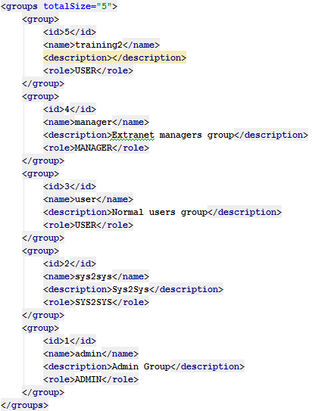
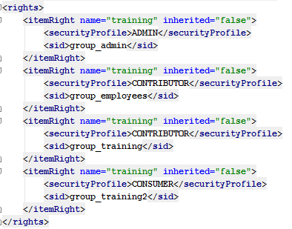
Groups, Roles, Rights - example

Slide 20
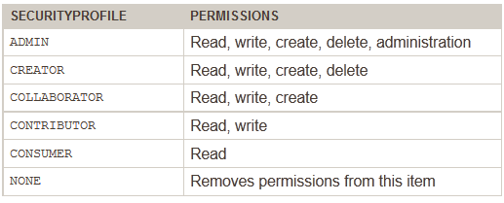
Permissions: Security profiles
A group of permissions
A combination of Spring base permissions: administration, create, read, write, delete
In CXP Manager
Can Administer
Can Edit, Can Personalize
-
-
Can View
No Access
Notes:
Permissions are assigned to security profiles. Permissions defines certain actions that can be performed.

Slide 21
Aggregated Security Profile
A user can belong to one or more groups
Multiple groups possible to define through Portal APIs but not through CXP Manager
When aggregating two groups, the more powerful groups is taken
User { admin, user } = admin
User { user } = user

Slide 22
Portal Authorization
Database
User Preferences DB
Portal Templates
Portal Database
Portal Authorizer
Portal Renderer
Portal ID
User Credentials
Recognized Device

Slide 23
Item Security (Authorization)
Advanced Security

Slide 24
Item Security
Items can be secured. The following are regarded as items:
Portals
Pages
Containers
Widgets
Links
Templates
Security inheritance
Items inherit the security of their parent item

Slide 25
Setting Item Security
Via CXP Manager
Via REST API
Via JAVA API
Via XML import scripts
Notes:
4 ways to change an item’s security settings

Slide 26
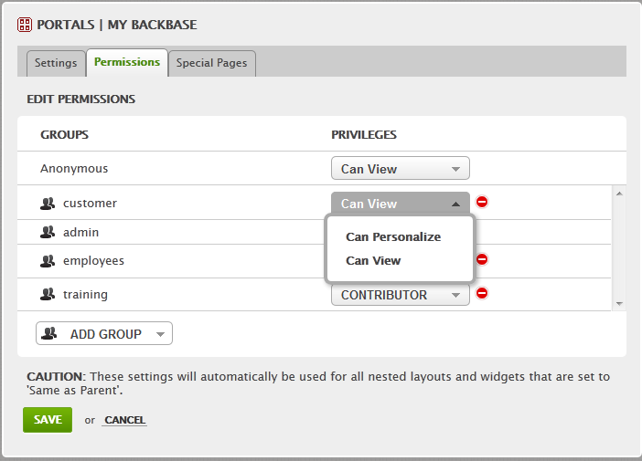
Securing Items Via CXP Manager
Permissions tab for each portal item

Slide 27
Securing Items Via Rest API 1/2
For most of the portal items, you can set the access permissions through REST API using appropriate URLs:
/portals/[portal_name]/rights
/portals/[portal_name]/pages/[page_name]/rights
/portals/[portal_name]/containers/[container_name]/rights
/portals/[portal_name]/widgets/[widget_name]/rights
/portals/[portal_name]/links/[link_name]/rights
/templates/[template_name]/rights

Slide 28
Securing Items Via REST API 2/2
XML format for defining rights:
<rights>
<itemRight>
...
</itemRight>
<propertyRight>
...
</propertyRight>
</rights>
<itemRight name="index" inherited="false"> <securityProfile>ADMIN</securityProfile>
<sid>group_admin</sid>
</itemRight>
<propertyRight name="index" inherited="false">
<securityProfile>ADMIN</securityProfile>
<sid>group_admin</sid>
</propertyRight>
Notes:
itemRight - Rights associated with the object.
propertyRight - Rights associated with the properties of the object.

Slide 29
Securing Items Via Java API
In Java, you get managed items rights through the ItemBusinessService<T extends Item> interface:
List<Right<? extends Sid>> getRightsForItem(String portalName, String itemName)
void updateRightsForItem(String portalName, String itemName, List<Right<? extends Sid>> rights)

Slide 30
Securing Items Via XML Import Scripts
In importPortal.xml you can include XML definition of rights
<?xml version="1.0" encoding="UTF-8" standalone="yes" ?>
<backbase-portal-import>
<portal-import>
...
<rights-file>rights-anonymous.xml</rights-file> ...
<pages>
...
<rights-file>rights-restricted.xml</rights-file> </pages>
... </portal-import>
</backbase-portal-import>
<?xml version="1.0" encoding="UTF-8" standalone="yes"?>
<rights>
<propertyRight name="ItemRef">
<sid>role_anonymous</sid> <securityProfile>CONTRIBUTOR</securityProfile>
</propertyRight>
...
</rights>

Slide 31
Exercise - Authorization
Start portal and login to CXP Manager
Create new pages
Secure a page via CXP Manager
Secure a page via the REST API
Notes:
Tip: https://docs.backbase.com/portal/5.4.2.0/refc_rest.html

Slide 32
Authentication Providers
Advanced Security

Slide 33
Default Authentication Providers
Portal Authentication Provider (Set up as blank archetype dependency. Remove for production!)
JDBC Authentication
LDAP
JAAS
CAS
Pre-Authentication (e.g. application container)
NOTE: You need to override/implement the mapping!
<!-- default authentication plugin -->
<dependency>
<groupId>com.backbase.portal.foundation</groupId>
<artifactId>security-portalserver</artifactId>
<version>${portal.server.version}</version>
</dependency>

Slide 34
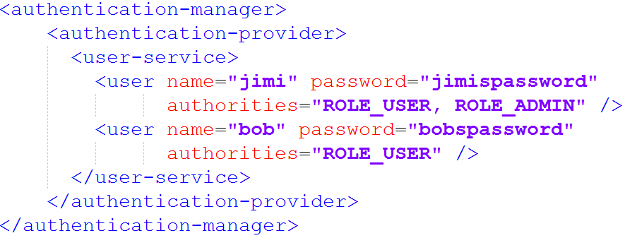
Authentication Manager
In-memory authentication provider

Slide 35
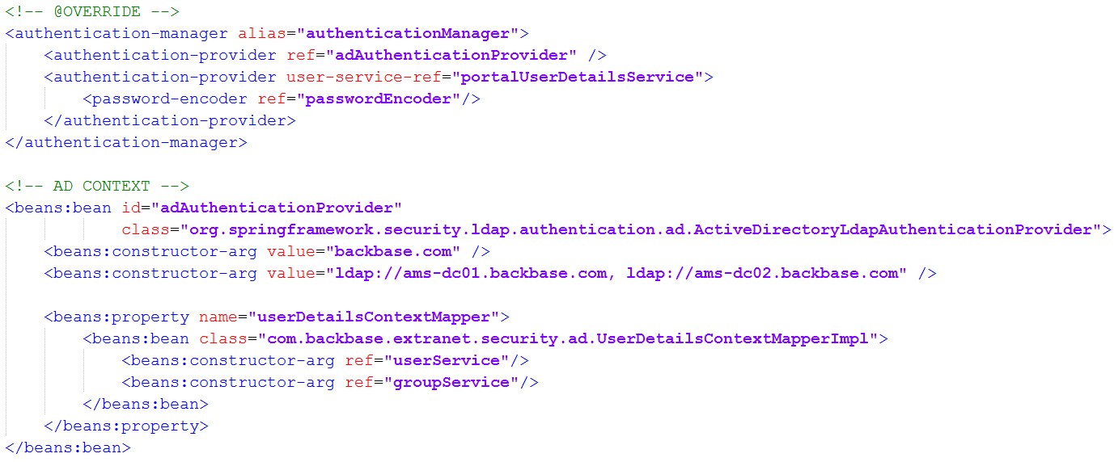
Configuring backbase-portal-business-security.xml
Example with two authentication providers
Internal Portal Database
Our implementation class

Slide 36
Custom UserDetailsContextMapper (ActiveDir.)
import com.backbase.portal.foundation.domain.model.Group;
import com.backbase.portal.foundation.domain.model.Role;
import com.backbase.portal.foundation.domain.model.User;
public class UserDetailsContextMapperImpl implements UserDetailsContextMapper {
private UserBusinessService users;
private GroupBusinessService groups;
public UserDetailsContextMapperImpl(UserBusinessService users, GroupBusinessService groups) {
this.users = users; this.groups = groups;
}
...
@Override public UserDetails mapUserFromContext(DirContextOperations ctx, String userName, Collection authorities ) {
...
User user = users.getUser(userName);
user.getGroups().add(groups.getGroup( “EMPLOYEES” ));
...
return user;
}
}
Notes:
Example implementaion of the UserDetailsContextMapper for Active Directory authentication provider.

Slide 37
Authentication Mapping - Challenges
Be aware of the complex mapping of users and groups
Authentication provider should map authenticated users to portal users
You get personalization conflicts if user ID’s are not matching
Note: Steer clear of complex user mapping. It becomes a huge maintenance issue between the portal and the security provider
Notes:
Steer clear of complex user mapping. It becomes a huge maintenance issue between the portal and the security provider

Slide 38
Exercise – LDAP Authentication Provider
Integrate and configure an LDAP authentication provider
How To Guides » Security » Integration and Configuring Spring Security Providers – LDAP Integration

Slide 39
Custom Authentication Provider
Advanced Security

Slide 40
Authentication Provider Interface
You can write your own authentication provider by implementing the authentication provider interface:
org.springframework.security.authentication.AuthenticationProvider
Two methods:
authenticate(Authentication authentication)
Performs authentication
In portal you may need to create portal a new user if necessary
supports(Class<? extends Object> authentication)
True if provider supports the indicated Authentication object
Default token is UserNamePasswordToken

Slide 41
Exercise – Custom Authentication Provider
Create a custom authentication provider
Implement the AuthenticationProvider interface
Use UsernamePasswordAuthenticationToken
Keep users locally in Class.
Automatically create users in portal database
Assign default user groups
Notes:
The relevant authentication provider class for this exercise is in the training bundle.
To generate passwords, use http://md5sum.org/
Edit src/main//resources/META-INF/spring/backbase-portal-business-security.xml (if not present, copy it from target/<project-name>/WEB-INF/lib/security-portalserver.jar!/META-INF/spring/, but you will need to run mvn jetty:run-exploded first)
Add <beans:bean id="myAuthenticationProvider" class="com.backbase.exercises.security.ExampleAuthenticationProvider"/> under <beans:beans>
and <authentication-provider ref="myAuthenticationProvider"/> under <authentication-manager>
After the exercise is implemented, login with a user not in the hashmap from the getUsersAndPasswords method. You should get a “Username or password does not match” response. After this, login with a valid user/password.

Slide 42
Multitenancy
Advanced Security

Slide 43
Multitenancy
Multi-tenancy is an architecture in which a single instance of a software application serves multiple customers.
A single portal server can hold multiple portals.
A “portal” equals “tenant”
Each portal can have different authentication mechanisms, different authorizations, different login/logout pages.
Problem: How to configure a secure multi-tenancy architecture in one single web application configuration (web.xml, spring-security-context.xml)

Slide 44
Multitenancy: Configuration
Spring Security > 3.1.x
Multiple <http> elements possible
Each <http> element can have a “pattern”
Override backbase-portal-presentation-security.xml
<http pattern="/css/**" security="none"/>
<http pattern="/login.jsp*" security="none"/>
<http auto-config='true'>
<intercept-url pattern="/**" access="ROLE_USER" />
<form-login login-page='/login.jsp'/>
</http>

Slide 45
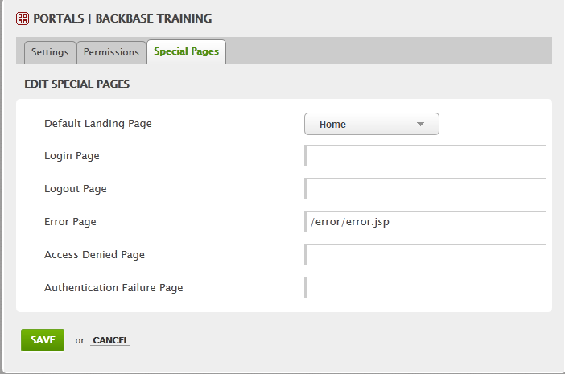
Multitenancy: Portal Special Pages
Notes:
Good example of multitenancy. Each portal can have different security setting on the Special pages tab.

Slide 46
Widget Security And Single Sign-On (SSO)
Advanced Security

Slide 47
Widget Security
Widgets are small applications with their own security.
Local widget - portal and widgets are within the same application context
Remote widget - portal and widgets are in separate application contexts (and could even be in different technologies)

Slide 48
Local Widgets, Share the Same Context
Hallo User X
Local widget 1
Local widget 2
Login
Local widget 3
Local widget 4
Notes:
If all (portal and widgets) are same application how would you implement this?

Slide 49
Security Service: Local Widgets
Existing Authentication Provider
MSAD
LDAP
Other…
Portal Application
Security Service (Spring Security Connector configuration)
Portal Services
Local Widget
Local Widget
Common Application Session
Notes:
When all widgets are local to the portal, the security setting are applied implicitly during the proces flow in the portal

Slide 50
Remote Widgets, Shared Session
Hallo User X
Remote system
Local widget 1
Remote widget 1
Local widget 1
Login
Local widget 2
Remote widget 2
Local widget 2
Notes:
This diagram shows how remote widgets bypass the internal process flow that has security. The next diagram show how to add security to the remote widgets

Slide 51
Security Service: Remote Widgets
Existing Authentication Provider
MSAD
LDAP
Other…
Existing SSO service
Portal Application
Remote Server
Security Service (Spring Security Connector configuration)
Portal Services
Local Widget
Local Widget
Remote Widget
Notes:
The portal and the remote widgets will need to connect to the authentication provider THROUGH the SSO service.
The mechanism for the portal to do this is the security service. The portal internally gets the information of the user principal via a spring security connector.

